Slide 1

Supplement Sales Prediction
Analytics Vidhya Jobathon Sep21
Varishu Pant
+91-7042626395
varishupant@gmail.com
https://linkedin.com/in/varishu-pant/
https://github.com/VarishuPant99/
https://medium.com/@varishupant

Slide 2
About the Data
Source: Analytics Vidhya
Event: Job-a-thon September 2021
Files: TRAIN, TEST_FINAL, SAMPLE
Context- Daily Sales of 365 stores from 1st Jan 2018 to 31st May 2019
Problem Statement- Predict sales of each store for the next 2 months
Wrangling
&
Exploring
Feature
Engineering
Model
Selection
Tuning
And Predicting

Slide 3
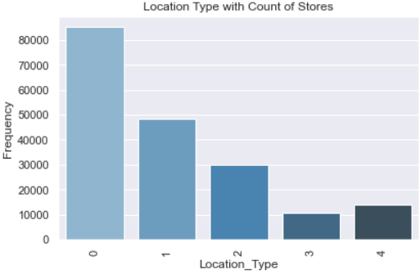
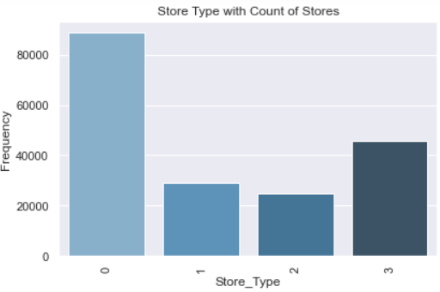
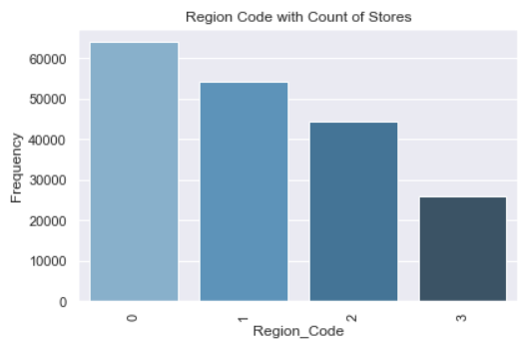
Exploratory Data Analysis
No. of orders is not available in test set, hence not considered
No missing values in either dataset
Sales is highly skewed with some values as 0 but none negative
Most stores are of Store Type 0
Most stores are located at Location Type 0
Most stores are in the Region Code 0

Slide 4
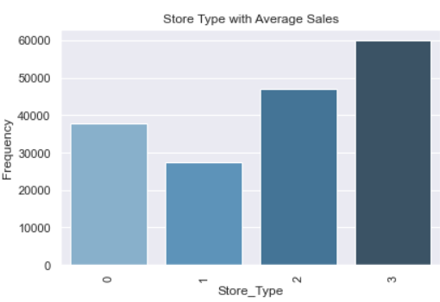
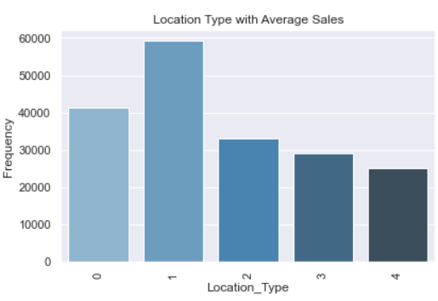
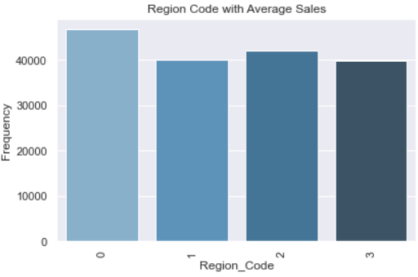
Exploratory Data Analysis (More Insights)
Highest Average Sales is of the Store Type 3
Highest Average Sales is of the Location Type 1
Highest Average Sales is of the Region Code 0

Slide 5
Feature Engineering
Using Date - Month, Week, Day
Mean Sales Encoding- By store, By week, By month
Encoding with Dimensions-
Weekly_Reg_Sales: Mean Sales By Region,Location,Store_Type,Week,Holiday,Discount
Weekly_Holidays: Total Holidays By Region, Location, Store_Type, Week
Date_block_num : Year and Month pairs
Lag Features grouped by Date_block_num and Store_id:
Monthly_Sales(Avg)
date_avg_Sales
Date_store_type_avg_sales
date_location_avg_sales
date_region_avg_sales
Trend Variable - delta_Sales_lag (Trend of avg monthly store sales by date_block_num)

Slide 6
Model Selection
Experimented with subsets of variables on:
Catboost Regressor
XGBoost Regressor
K- Nearest Neighbours
Random Forest
SGD Regressor
MLP Sequential Architecture
Ensemble using Elastic Net on Level 1 predictions
Post tuning hyperparameters, best approach:
XGBoost
AV Score (MSLE * 1000) -
237.05

Slide 7
Thank You !

